Slide 1

Classification Problems and Ensemble Methods
Chris Hamling
AI Software Engineer – ATC AI/ML
March 28th, 2019

Slide 2
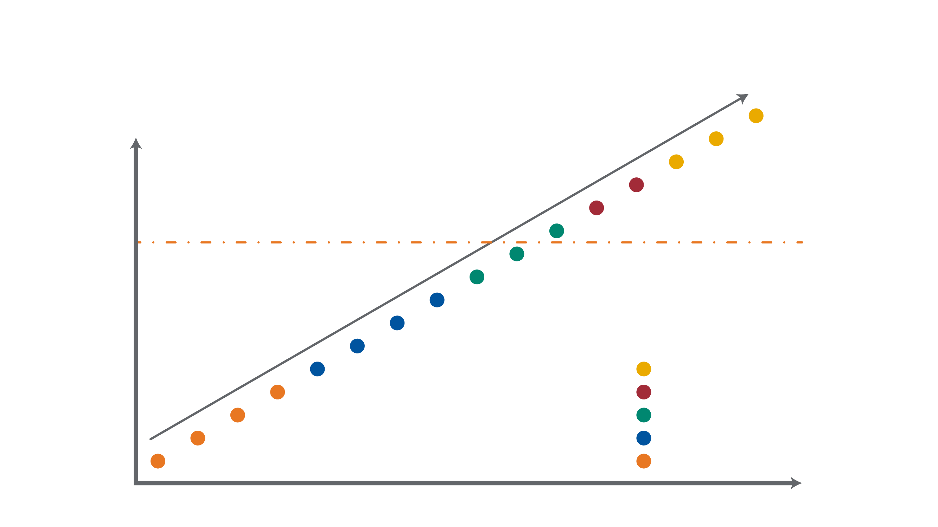
Terms and Definitions - What is Artificial Intelligence
Data Centric View
Reasoning
Learning
ML/AI
Natural Language
Optimization
Rules
Demarcation Line
Predictive Modeling
Forecasting
Statistical Analysis
Context Specific Usage
Alerts
Drilldown Query
Ad Hoc Reports
Standard Reports
Cognitive
Big Data Platforms
Analytics
Prescriptive
ECM
Predictive
Information Integration
Descriptive
RDBMs
Information Foundation
Natural, Intuitive or Automated Interaction

Slide 3
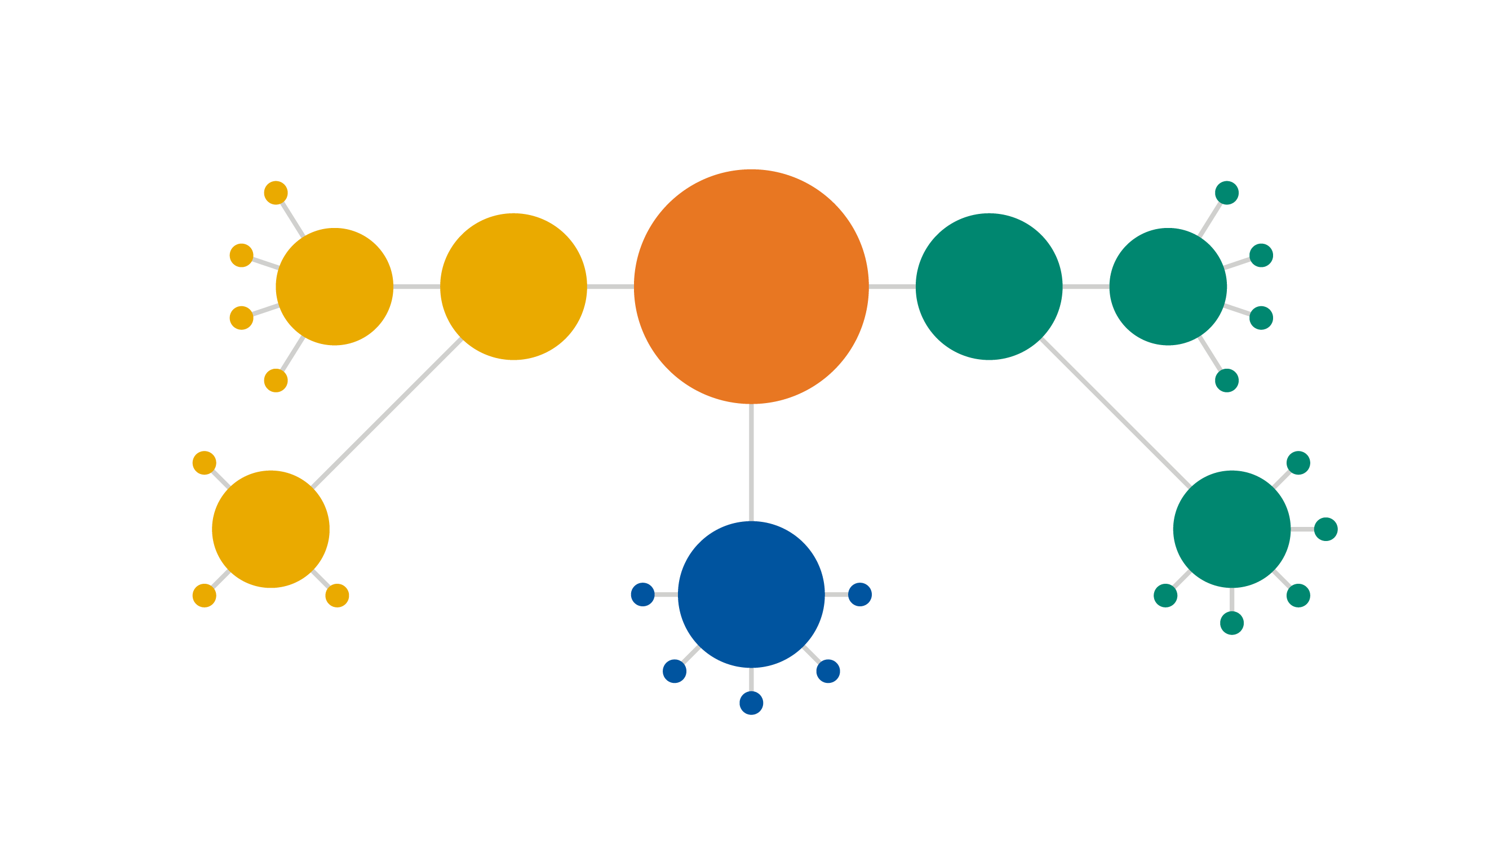
Machine Learning Methodologies - Overview
Feature Elicitation
Identity Fraud Detection
Structure Discovery
Image Classification
Dimensionality Reduction
Unsupervised Learning
Machine Learning
Supervised Learning
Classification
Meaningful Compression
Customer Retention
Big Data Visualization
Diagnostics
Recommender Systems
Clustering
Regression
Weather Forecasting
Market Forecasting
Targeted Marketing
Customer Segmentation
Real-time Decisions
Game AI
Reinforcement Learning
Popular Growth Prediction
Estimating Life Expectancy
Robot Navigation
Skill Acquisition
Advertising Popularity Prediction
Learning Tasks

Slide 4
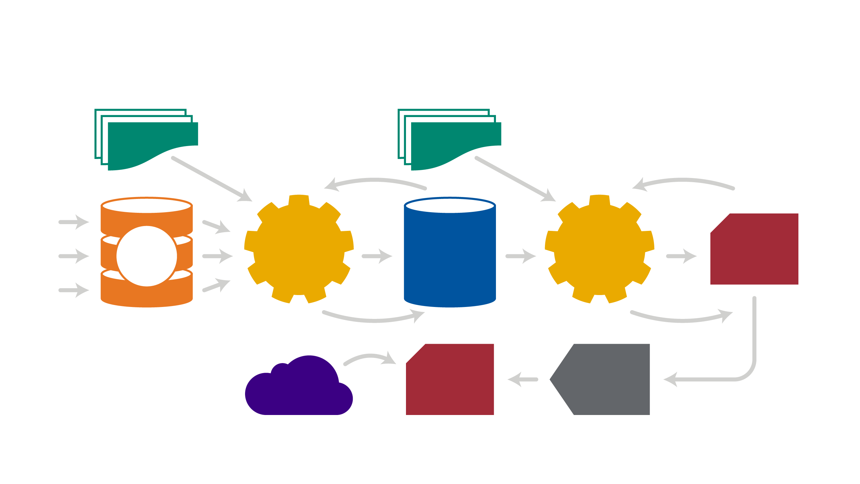
Machine Learning - Generic Workflow
Data Processing Tools
Machine Learning Algorithms
Iterate Until Data is Processed
Iterate to Get the Best Model
Data Providers
Raw Data
Pre- Processing
Structured Data
Learning Algorithms
Candidate Model
Select Data
Golden Model
Deploy Selected Model
Applications

Slide 5
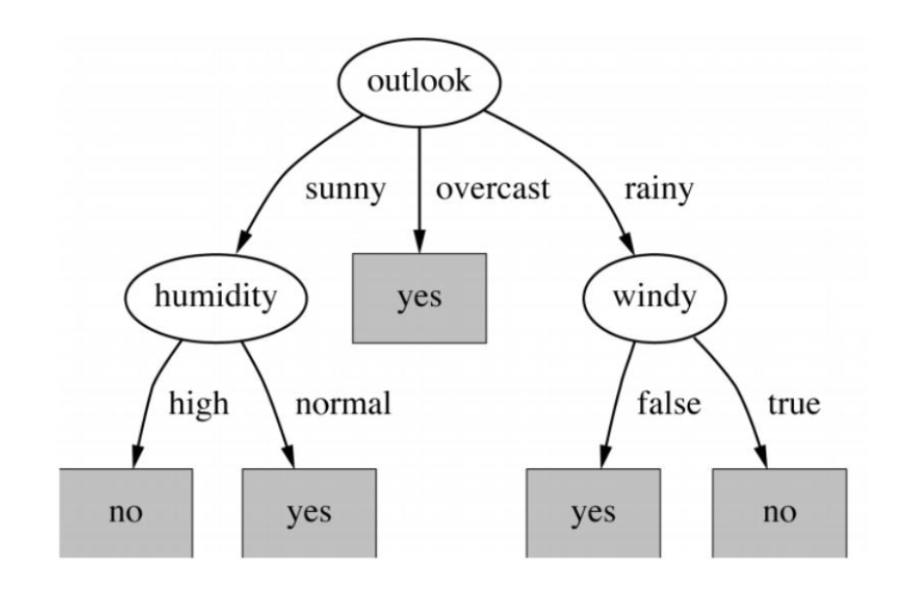
Fundamental Introduction – Decision Trees
Should I go outside?
In classification problems

Slide 6
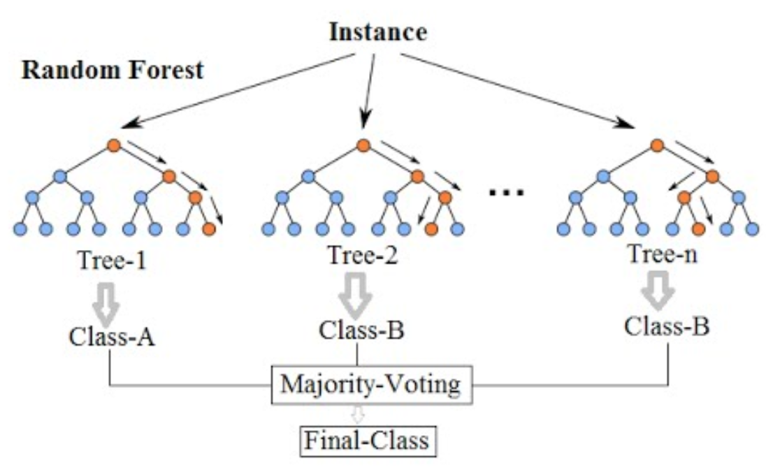
Algorithm Introduction - Random Forest
Introductory ensemble method as a collection of basic decision trees
Randomly create n decision trees to individually decide the outcome
The aggregate decision of all trees voting will be the final prediction of the random forest

Slide 7
Algorithm Introduction – LightGBM
Gradient Boosting Model, comparable to XGBoost
Similar but more complex implementation of a decision tree ensemble method
More thoughtfully appends new trees over time to decrease error

Slide 8
Demo Use Case – Heart Disease Prediction
Dataset from UC-Irvine ML Repository (303 records)
Data includes individual health characteristics and a target of heart disease diagnosis
Goal is to train on the data and predict if a given patient has heart disease

Slide 9
Review and Future Learning – Ensemble Methods
Voting
Averaging
Bagging (bootstrap aggregating)
Random Forest
Boosting
Gradient Boosting Models
Stacking

Slide 10
My Gift to You
Artificial Intelligence Repository
matt-versaggi.com/mit_open_courseware
This is the AI Repository compiling years of biz / tech AI materials in this one space.
Secure Group: “WebAuthOnlineStorage_Box”
Actively Maintained

Slide 11
Questions?

